Slide 1
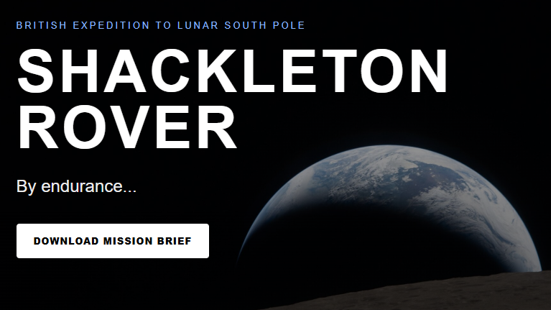

Slide 2
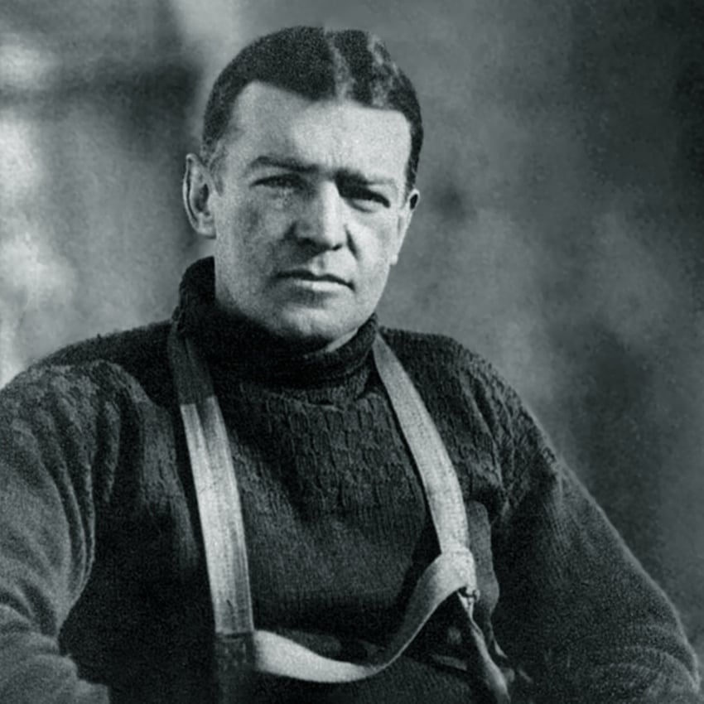
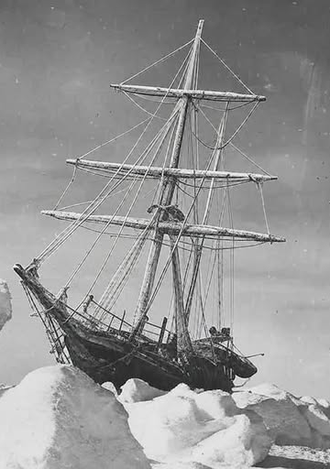
Background The story of Sir Ernest Shackleton > Led 1914 Endurance expedition to Antarctica > Ship became trapped in ice, then sank > 28 men walked 500 miles, dragging lifeboats > Reached edge of ice, got into lifeboats, rowed > Another 100 miles in lifeboats to barren island > 10 days later, 6 men begin 800-mile voyage > Landed, crossed South Georgia, sent telegraph > Organised rescue operation > Saved every single man
SY Endurance, trapped in ice, 1915. Photo by Frank Hurley

Slide 3

A lunar adventure Patrick Harkness Professor of Exploration Technology University of Glasgow The Shackleton project is a proposal for a CLPS rover to the lunar south pole. A full list of supporters may be found at shackletonrover.co.uk > personnel

Slide 4
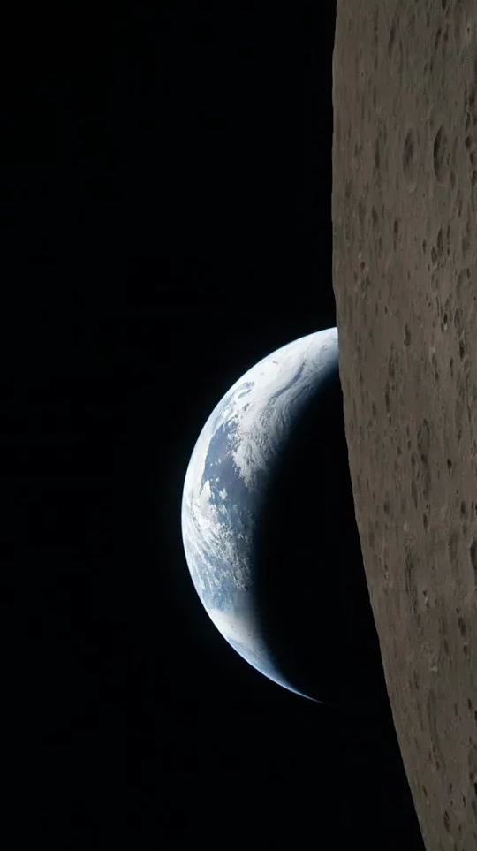
The expedition Why Moon? The UK does many things. A surface mission will unite capability around a clear exploration goal and secure a role in the emerging lunar economy. What economy? Lunar resources, especially water ice, will be vital to a sustainable space economy. However, there is still no ground truth. We can provide it, for all. Which partners? We intend to work with Intuitive Machines, and to develop partnerships with potential operations teams in Canada and Australia.

Slide 5
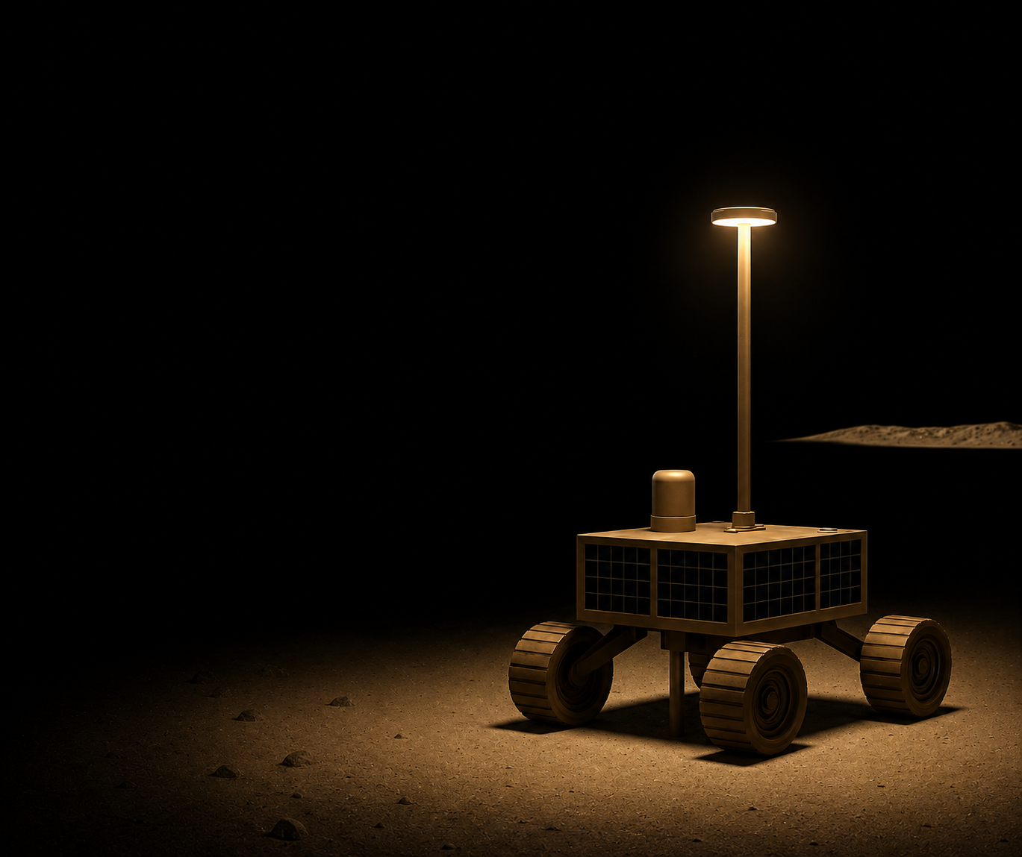
The rover Architecture: We are currently proposing a 20kg rover with skid-steering and S-band comms via the CLPS lander. Duration: Nominally 14 days, using solar power, with batteries for 1h dark sorties. However, radioisotope heaters may permit survival. Payload: A penetrator payload with heaters to evolve gases and an associated mass spectrometer. Regolith thermo-mechanical properties to be measured.

Slide 6
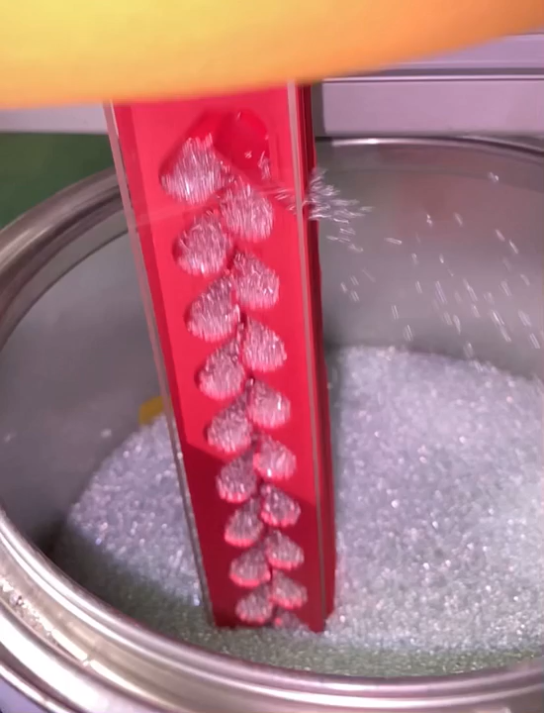
The payload Problem: Weight and torque are extremely constrained. Most drilling rovers are at least an order-of-magnitude more massive. Proposal: Options such as pulse-elevator can permit drilling outside the traditional augering approach. This concept is already on the UK technology roadmap. It works… Work to do: We still need to manage the vibration loads, but at least it’s a dynamics problem, not a statics one…

Slide 7
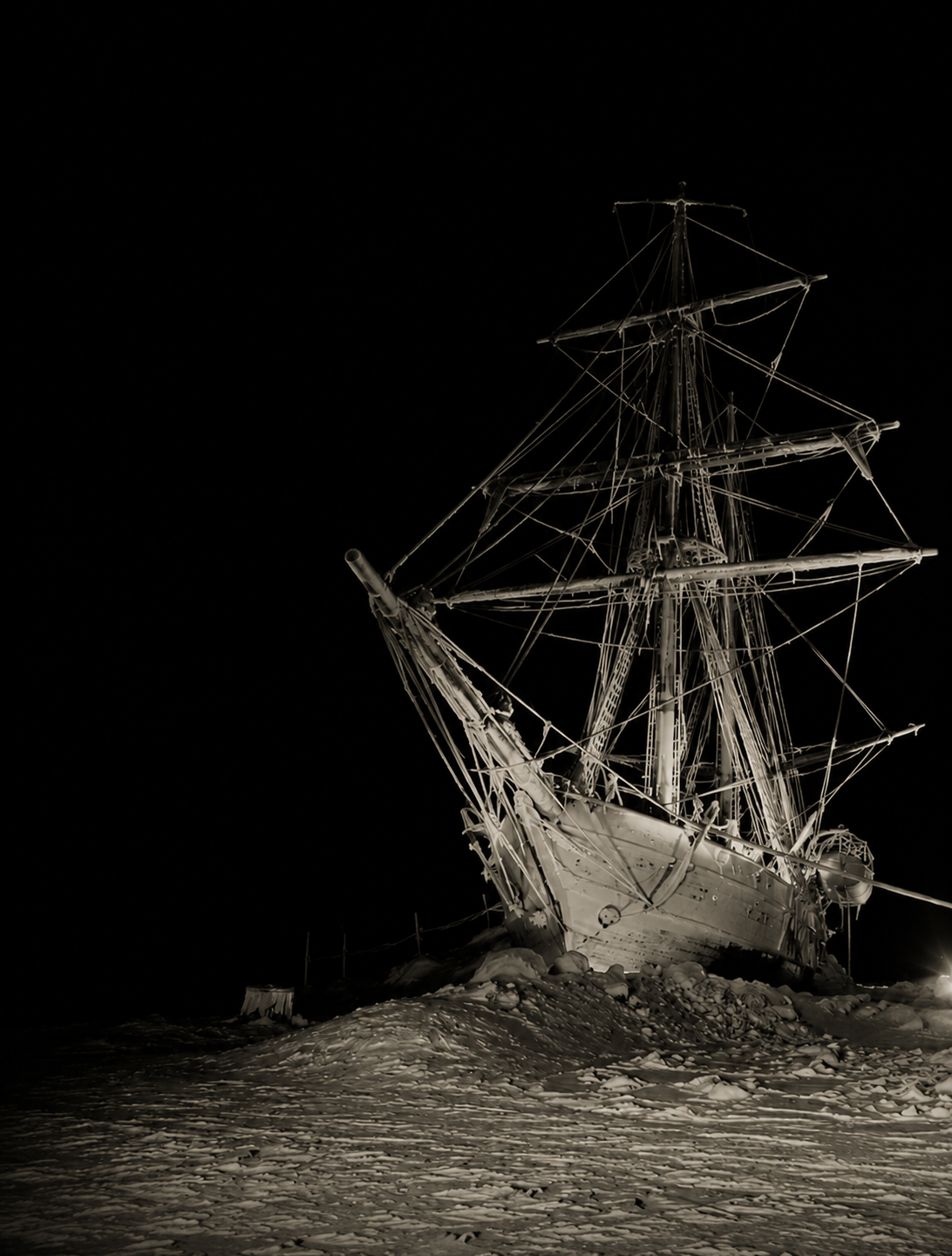
The vision Science goal: A short window of time still remains in which transformation could be delivered by a small rover. Global impact: We will set the Antarctic example to promote a new global commons at the Moon. We will even fly a piece of the RRS Discovery. National focus: We will echo an unsurpassed story of moral optimism to set a renewed example: ambition, discovery, and responsible exploration at the next polar frontier. A clear and historic goal will inspire ambition, vision, and STEM.

Slide 8
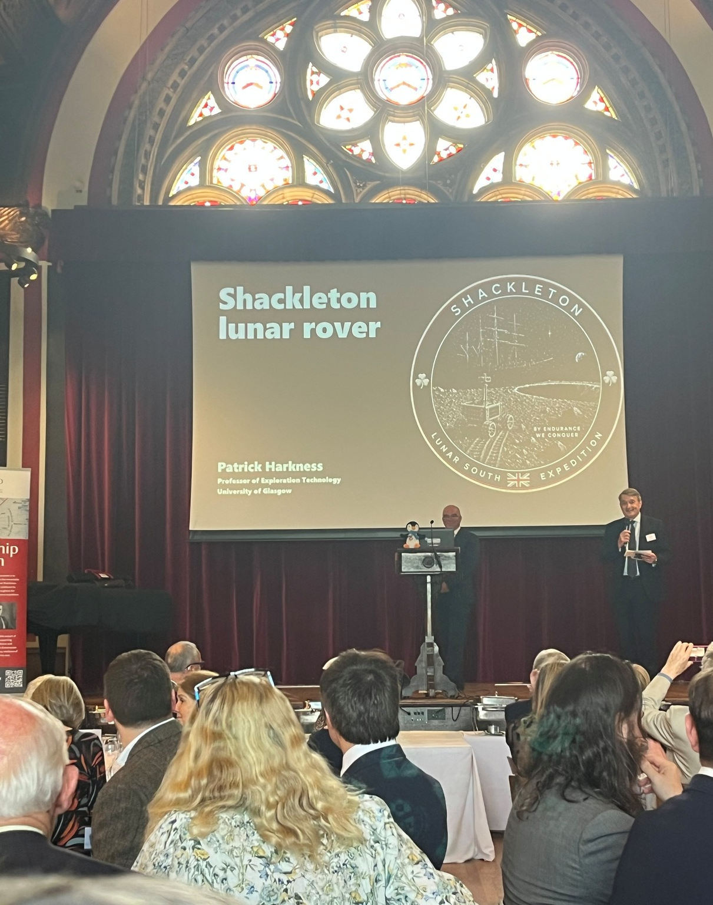
The way forwards The price: Around £25m. The plan: We have a White Paper in Frontiers 2035, but – as speed is crucial – we are also seeking around £20m in private finance. What is the likelihood of success: We do not know, unless we try. However, peer nations have shown that this is possible. We know what Sir Ernest would do…

Slide 9
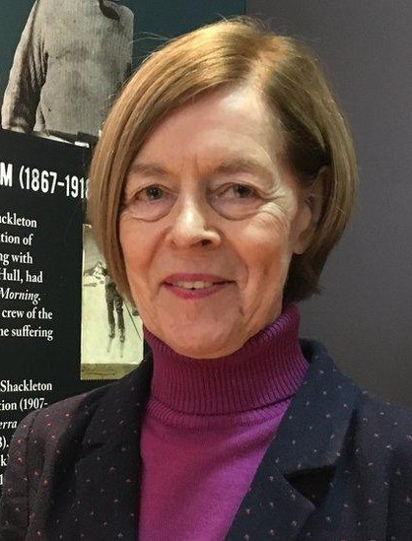
Our mission patron The Honourable Alexandra Shackleton: “My grandfather, Sir Ernest Shackleton, listed the qualities required for a polar explorer thus: optimism, patience, imagination, and courage. I believe that he would recognise these qualities as motivating this proposal, and I am therefore delighted to commend it to you.”

Slide 10
How you can help - To learn more, please visit shackletonrover.co.uk and download the papers. To sign up, please contact me at patrick.harkness@glasgow.ac.uk. To promote, please use your initiative!

